Slide 1
Solution Manager 7.2
HANA & BI Monitoring
(Setup & Configuration)
Trainer: Baldeep Singh

Slide 2
Introduction
Concept:
In BI scenarios it is critical to ensure that end users retrieve up-to-date information from the BI solution. This requires sufficient performance and availability of all involved components. BI monitoring has the capabilities to ensure that the involved technical systems and components are working as expected.
Customer Scenario:
Data from backend systems (SAP ERP) are extracted into data warehouse systems (SAP BW). In case of SAP BW this is done via process chains defined in the SAP BW systems. The resulting data is stored within info objects in the SAP BW systems. This data can be viewed by end users via so-called queries or templates which are also defined within the SAP BW systems.

Slide 3
Introduction
The definition and scheduling of the jobs, process chains, queries and templates is normally directly performed with the help of standard BO or BW tools like the BO Info View / BI launch pad tool or inside the BW transaction RSPC. The main challenge is -- How to control and monitor BO jobs, BW process chains, queries and templates?
At the minimum, top business critical jobs, process chains, templates and queries should be monitored and an immediate resolution has to be found in case of a problem. Before BI Monitoring in the past, manual monitoring via system local tools had to be performed.

Slide 4
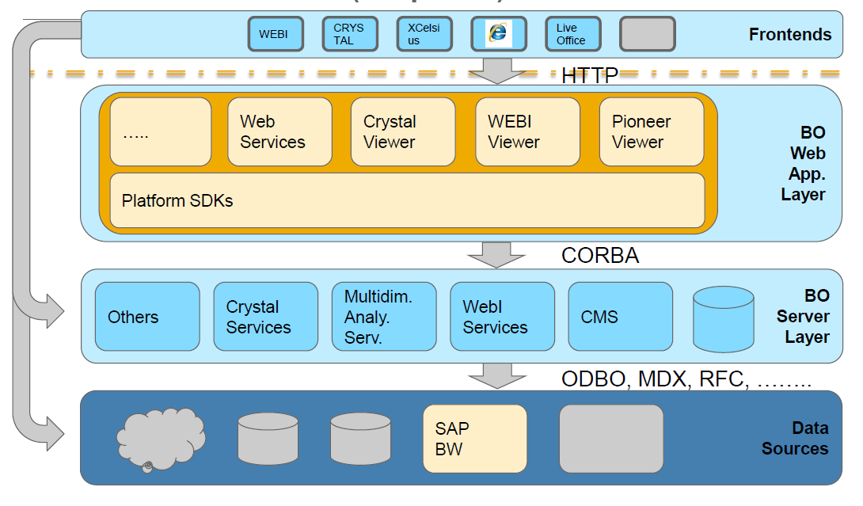
Introduction
SAP BusinessObjects Business Intelligence 4.0 Architectural Overview (simplified)

Slide 5
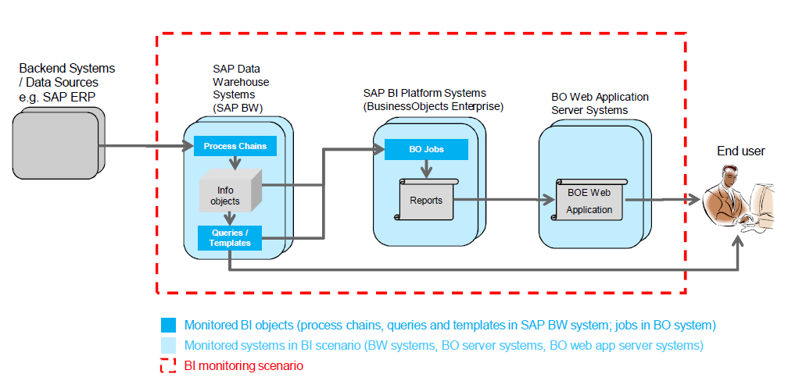
Introduction
BI Monitoring Scenario:
This picture shows a typical BI scenario (between backend systems and end user). Two monitoring levels are provided:
• System level monitoring for the involved technical systems
• Monitoring of important BI objects (process chains, queries, templates, BO jobs)

Slide 6
Introduction
Following are the key questions that arise during monitoring of typical BO BW customer landscape:
Do the most important BW Process Chains run with good performance and finish successfully?
Are my Business Objects jobs executed as planned and are they running with good performance?
Do I have somewhere a delay in my Business Warehouse Process Chains processing which hinders right in time delivery of business-critical data?
Do I have a resource bottleneck somewhere in my Business Intelligence solution? Am I automatically informed about it?
Did the process chain process too many/few records?
Were too many/few data packages processed in process chains?
Are BO jobs running into a status indicating an error or warning?

Slide 7
Introduction
BI Monitoring Scope & Benefits
Central system status overview for all technical components involved in SAP Business Intelligence Solution
Capability to monitor cross-system SAP BW process chains and single process chain steps
Central monitoring of SAP BW queries and templates
Central monitoring of Business Objects specific jobs and correlation to system specific metrics
Integration of Business Intelligence specific alerts in Alert Inbox including Notification Management, Incident Management, Task Assignment and forwarding to 3rd party
BI Monitoring is to centrally perform proactive monitoring of Business Intelligence solutions based on SAP BW and BOE XI including BW Process Chain and BOBJ Job Monitoring and Alerting.

Slide 8
Introduction
Data Readiness Monitoring Scope & Benefits
To enhance the BI Monitoring functionality SAP offers the Data Readiness Monitoring (DRM) application inside BI Mon.
Data Readiness Monitoring – Goals
For each Data Readiness scenario, the underlying processes (BW process chains, ABAP jobs, Data Services jobs, …) are defined. For each process an individual data actuality is configured (defining how recent / actual the last successful run of this process has to be).
There are 3 KPIs that are provided by DRM:
  SLA: One point in time per day where the data should to be available. This is calculated by checking the last successful run in relation to a provided point in time that defines whether all data is considered as „ready“ or not.
  Current Status: The availability of the data right now.
  First Availability per Day: Shows the time stamp when the data was available the first time for a day.

Slide 9
Introduction
Usage of DRM:
We very often we have the case that end-users that come into the office early in the morning, need to know if the application data that was loaded during the night is already available for reporting.
To decide if the data can be used for reporting we can combine different jobs and process chains which are processed at different times into a scenario. For this scenario we analyze the result of each monitored object (that is setup already in BI Monitoring) and check if a successful run has happened in an acceptable time range. If this is true we say the data is ready for reporting.
Example: Sales Data must be available punctually at 08:00 in the BW system for reporting. We can check the corresponding ABAP jobs in the source system and process chains in the BW system and if all of them run successfully until 8:00 we say the data is available for reporting.
This information can be shown in the DRM application of Sap Solution Manager 7.2 or send via E-Mail to the business end users.

Slide 10
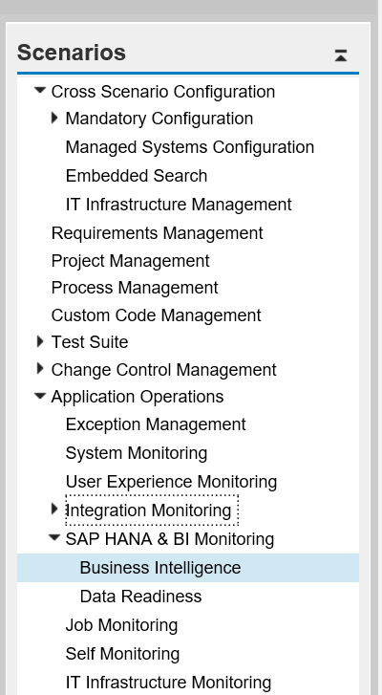
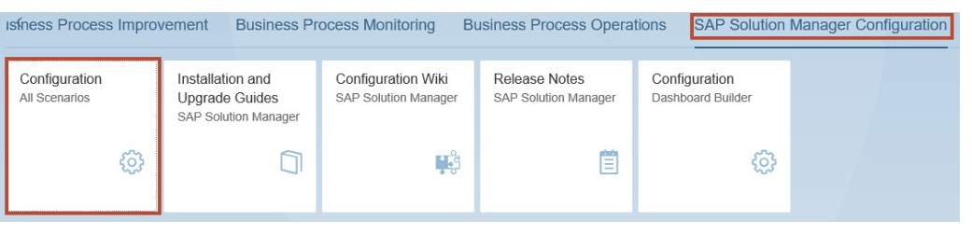
BI Monitoring Setup
To configure BI Monitoring starting from the SAP Fiori Launchpad of SAP Solution Manager, navigate to the tile group SAP Solution Manager Configuration and open the tile Configuration (All Scenarios).
<<----- Solman_Setup
SM_WORKCENTER

Slide 11
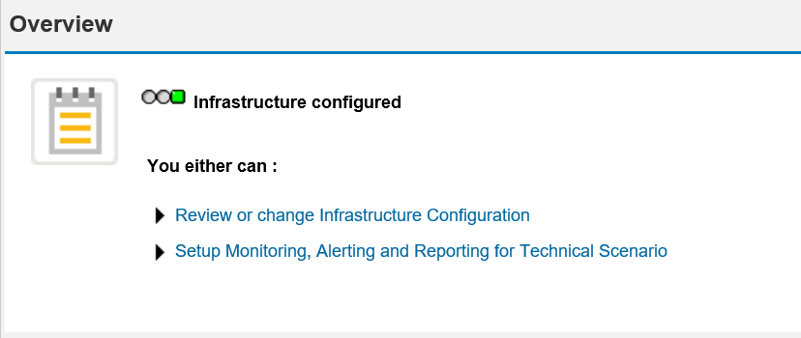
BI Monitoring Setup
Step 1: Overview
Gives you a short introduction which steps of the guided procedure have to be performed
The traffic light reflects the current configuration status of the monitoring infrastructure.

Slide 12
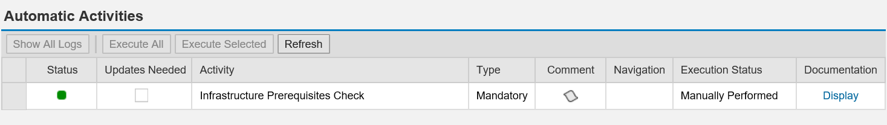
BI Monitoring Setup
Step 2: Configure Infrastructure
In the sub-steps of step 2, you configure the monitoring infrastructure, including important global settings for alerting, housekeeping etc.
Step 2.1: Check Prerequisites
In this step, you use the automatic activities to check the prerequisites for the configuration of the System & Application Monitoring infrastructure.

Slide 13
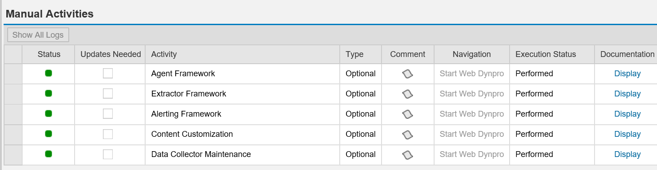
BI Monitoring Setup
Step 2.2: Configure Manually
In this step, you perform manual activities to configure the System and Application Monitoring infrastructure.

Slide 14
BI Monitoring Setup
  Step 2.3: Default Settings
  In this step you can enable or disable certain functions for the System & Application Monitoring on a global level (i.e. these settings affect all alerts from System Monitoring). It is possible to overwrite these settings on the level of templates as well as alerts.
    Automatic Incident Creation
    Automatic Notification
    Automatic Alert Confirmation

Slide 15
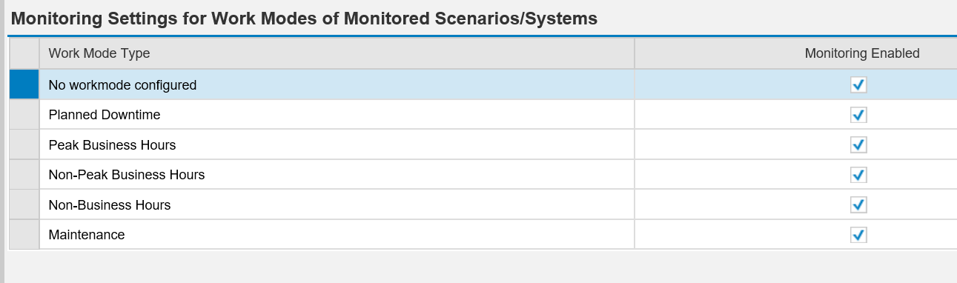
BI Monitoring Setup
Step 2.4: Workmode Settings:
  In this step, you configure the standard behavior of the monitoring use case, depending on the work mode. The settings affect all metrics and alerts of the monitoring use case. The work mode depends on the monitoring use cases.

Slide 16
BI Monitoring Setup
  Step 2.5: Update Content:
  A content version contains SAP monitoring content for all System and Application Monitoring scenarios.
  Improvements of content for your current support pack may become available over time, so always use the latest available content by updating your content whenever newer content is available.
  Concept for RCD is applied.

Slide 17
BI Monitoring Setup
Step 3: Standard Users
In this optional step, you can create standard users in the SAP Solution Manager system.
You have the following options:
Create New User : The system creates the new user and the corresponding business partner, if necessary, and assigns the relevant copied and SAP roles.
Provide Existing User: If you update an existing user, the system assigns the relevant copied roles and SAP roles to an existing user. If you have selected Accept Manually Created User Without Checking Roles Assignment, roles are not assigned to the mentioned user.
Update User Roles: The system assigns the relevant copied and SAP roles to the selected current user ID.
Update Password: You assign a new password to the selected current user ID.

Slide 18
BI Monitoring Setup
Step 4: Define Scope
Define Scope allows you to define the scope (=“scenario”) to be covered by a HANA and BI monitoring scenario. You need to “Create” a new BI monitoring scenario and give it a unique name.
In this step, you select the technical scenario to configure for HANA and BI monitoring. A scenario is a set of technical systems. Select a scenario to proceed to the next setup steps.
To create a scenario, choose the button Create. A wizard for creating a scenario is displayed in a new browser window.
  In step Enter Name/Type, enter technical name and a human-readable description of the scenario.
  In step Select Technical Systems, add the technical systems in the scenario, grouped by BO Web Systems, BO Server Systems, BW Systems, Data Services Systems, SLT Systems, HANA Systems, SAP ABAP Source Systems.
  In step Additional Layers, you can add further technical systems to the scenario, again grouped by the same system types as in the step before.
  In step Review, you can review the configured scenario and save it.

Slide 19
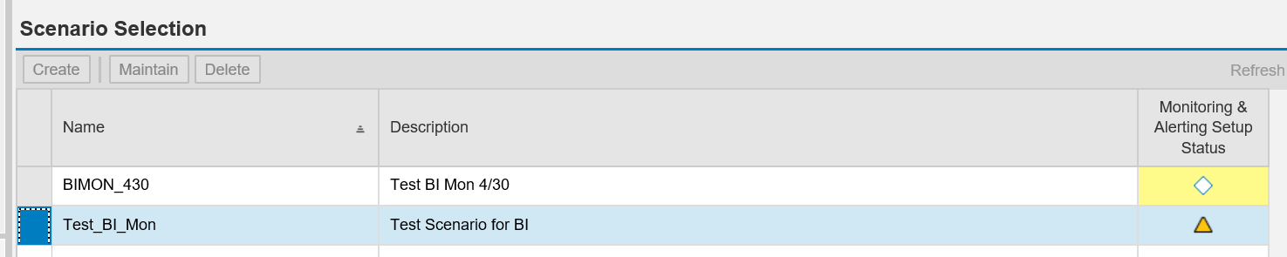
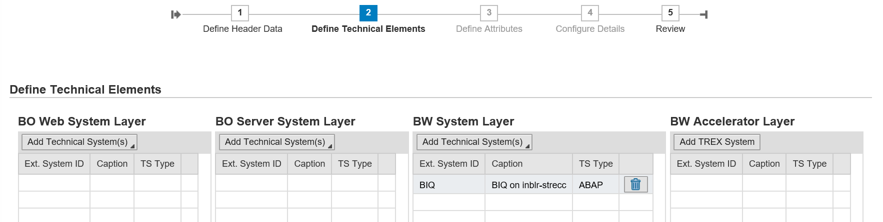
BI Monitoring Setup

Slide 20
BI Monitoring Setup
Step 5: Monitoring & Alerting
This section provides a guided procedure to set up BI Monitoring. All the steps apply to the Technical Scenario you selected in the Scope Definition. The monitoring and alerting setup steps are:
Business Objects Job Monitor Configuration (Select the BOBJ jobs to monitor, and define thresholds for various metrics)
BW Process Chain Header Monitor Configuration (select the BW process chains to monitor, and define thresholds for various metrics)
BW Report Monitor Configuration (select the BW reports (queries/templates) to monitor, and define thresholds for various metrics)
Data Services Monitor Configuration (select the Data Service jobs to monitor, and define thresholds for various metrics)
Activate configured monitors.

Slide 21
BI Monitoring Setup
Step 5.1: Configure Jobs
In this step, you configure the following jobs:
BW Process chain header
Business objects jobs
Data services
BW Report Monitor
ABAP jobs
Step 5.2: Configure BW Report Monitor
In this step, you define the BW reports (Bex queries/Templates) to monitor (including their thresholds).

Slide 22
Data Readiness Monitoring Setup
DRM application is based on job and process chain data. These data is retrieved by SAP Solution Manager from the Managed Systems, therefore BI Monitoring must be configured first.
Configure BI Monitoring or Job Monitoring scenario
  Create a BI Monitoring or Job Monitoring scenario and create the monitoring objects that are required for the DRM scenario (e.g. BW Process Chains, BO Jobs, ABAP jobs, …).
  Activate and check the data collection in SAP Solution Manager.
Configure DRM scenario
  Schedule the required DRM jobs in the ABAP stack of the SAP Solution Manager.
  Define reports, groups, availability details and further relevant details and enter this in the DRM configuration UI.
  The KPIs of scenario can be based on the following calculation models:
    Current Status (CS) – result is calculated/updated every 5 min.
    SLA – result is calculated only once per day at the expected time. Furthermore, you have to define the date, time step, time zone and optional recurrence pattern.
  Use the Assign functionality to select the relevant Monitored Objects that should be used in your scenario

